Slide 1
CRIMINAL IDENTIFICATION AND DETECTION
Submitted by
P . Anusha
99220041072
Evaluator
Dr . K. Kartheeban

Slide 2
Agenda
Introduction
Objective
Structure of Python Code
Implementation Of the Project
Functionality Of the Project
Conclusion

Slide 3
Introduction
Computer vision technology enables the automatic extraction, analysis, and understanding of meaningful information from images and videos. In the context of a Criminal Detection and Identification App, this translates to the ability to recognize faces, objects, and patterns within visual data. By harnessing this technology, law enforcement agencies can significantly improve their investigative capabilities, streamline surveillance efforts, and maintain comprehensive criminal registries.

Slide 4
Objective
The main goal of the Criminal Identification App is to help law enforcement officers identify and catch individuals who may be involved in criminal activities. The app uses advanced computer vision technology, like facial recognition, to accurately recognize people. It also allows for the surveillance of live video feeds, helping law enforcement monitor and respond to criminal behavior in real-time. The app is designed to be easy to use, with a user-friendly web interface, making it accessible for law enforcement personnel. Additionally, the app can keep a record of known criminals, making it a useful tool for tracking and preventing crimes. The objective is to provide law enforcement with a powerful and efficient tool for maintaining public safety and security.

Slide 5
Structure of
Python Code

Slide 6
Libraries used
import os
import streamlit as st
import cv2
import numpy as np
from PIL import Image
import face_recognition
from datetime import datetime

Slide 7
Computer Vision Algorithms
1.Face Detection:
The face_recognition.face_locations function is used for detecting faces in images. It likely employs a combination of algorithms, possibly based on Haar cascades or deep learning-based methods.
2.Face Recognition:
The face_recognition.face_encodings function is used to encode facial features for both the training images and the test images. This involves extracting unique features from the face, likely using deep neural networks.
3.Comparison of Faces:
The face_recognition.compare_faces function is employed to compare the facial encodings of the test image with those of the known (trained) images. This involves measuring the similarity between facial features.

Slide 8
Computer Vision Algorithms
4. Distance Measurement:
The face_recognition.face_distance function calculates the Euclidean distance between face encodings. It provides a measure of how similar or dissimilar the faces are.
5. Rectangle Drawing:
OpenCV functions (cv2.rectangle, cv2.putText) are used to draw rectangles around detected faces and display text identifying the recognized individual.
6. Attendance Logging:
The code includes a function named Attendance that logs the attendance of recognized individuals in a CSV file.
7. Webcam Integration:
The code uses OpenCV (cv2.VideoCapture) for accessing and processing video frames from a webcam or video file.

Slide 9
IMPLEMENTATION
Of the Project

Slide 10

Anaconda Integration
To seamlessly integrate our project with the Anaconda platform, we implement a straightforward process. This involves setting up the necessary dependencies and libraries within the Anaconda environment, ensuring compatibility and a smooth workflow. By incorporating our project into the Anaconda platform, we leverage its capabilities for efficient code execution and enhanced development.

Slide 11
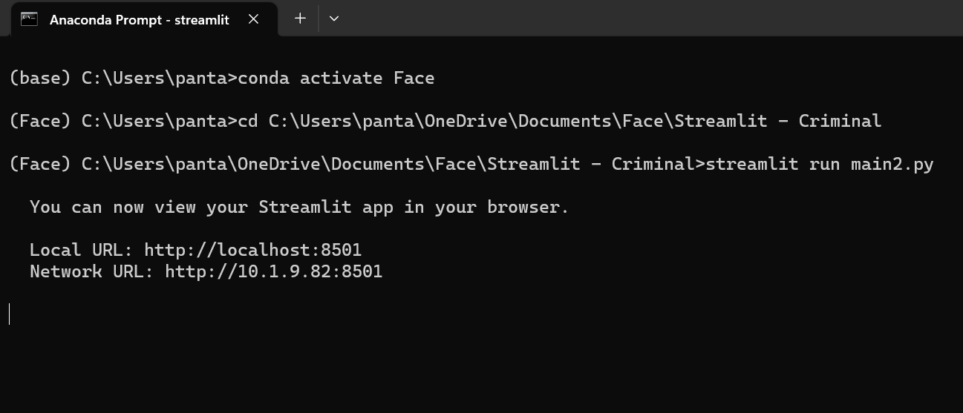
Creating Face Virtual Environment
To initiate the Face Virtual Interface for our project, we follow a straightforward process. This involves configuring the virtual environment within the Anaconda prompt, ensuring a separate and isolated space for running our facial recognition code. By creating this dedicated virtual interface named "Face," we prevent any interference with the base Anaconda interface, establishing a controlled environment for the seamless execution of our project.

Slide 12
Streamlit Integration
Streamlit is integrated into a Criminal Identification and Detection App, making the application interactive and user-friendly. Streamlit is a Python library that simplifies the process of creating web applications for data science and machine learning. The integration allows users to perform various tasks related to criminal identification and detection through a web interface.

Slide 13
FUNCTIONALITY
OF THE PROJECT

Slide 14
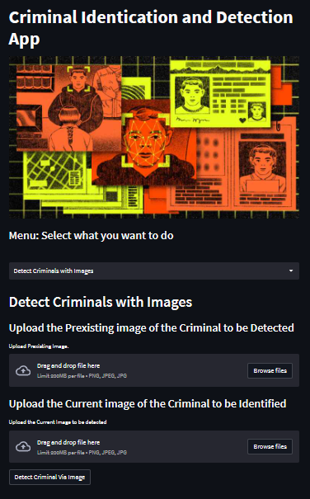
USER INTERFACE

Slide 15
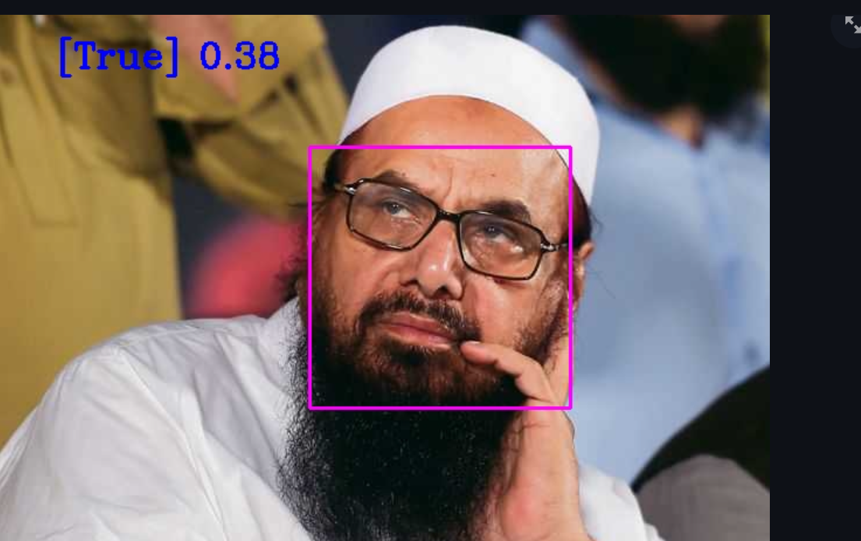
Image-Based Criminal Detection
The Image-Based Detection System is a critical component of our Criminal Identification and Detection App, leveraging advanced computer vision techniques. The system allows users to upload images of individuals for identification purposes. Upon uploading, the app employs computer vision methodologies to locate and analyze facial features, creating a unique facial signature for each individual. This signature is then compared with existing records in the criminal registry, facilitating quick and accurate identification.

Slide 16
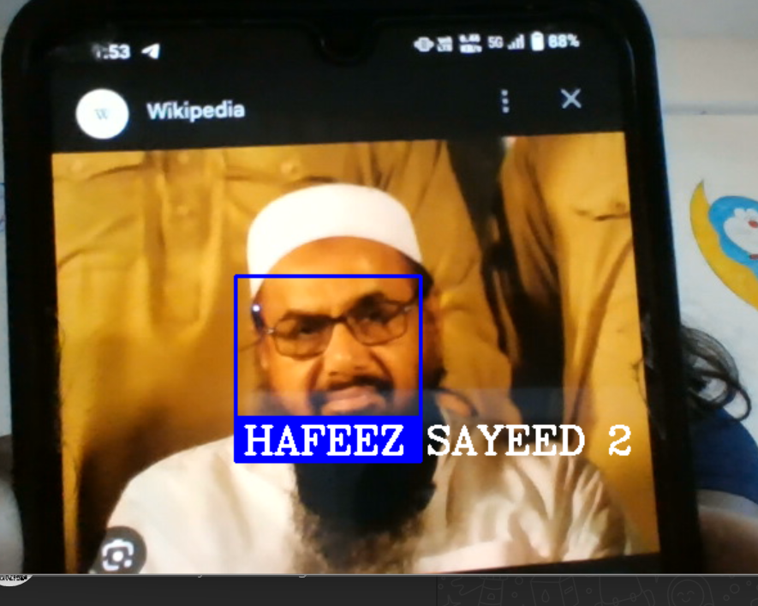
Video Surveillance Criminal Detection

Slide 17
CONCLUSION
In conclusion, our Criminal Identification App is a powerful tool for law enforcement, making it easier to find and recognize individuals involved in criminal activities. Using advanced technology like facial recognition, the app helps identify suspects by comparing their faces with known criminals in a secure database. The user-friendly interface ensures that law enforcement officers can navigate and use the app with ease. By combining various features like image-based detection and video surveillance, our app provides a comprehensive solution for enhancing public safety and supporting crime prevention efforts. It's a valuable asset in the hands of those working to keep our communities safe.

Slide 18
THANK YOU

